Slide 1

Catalog Marketing
Analytics Insights
By Saundarya Badhrinathan
Notes:
To change the image on this slide, select the picture and delete it. Then click the Pictures icon in the placeholder to insert your own image.

Slide 2
Initial Preparation
Coded the data to ensure the fields are in correct format
Utilized Proc Means and Proc Univariate to locate missing data
Discovered that zip code is missing in five households

Slide 3
Data Inspection
Several discrepancies were encountered
Refunds, cancellations, returns are handled differently between offers prior to 2007 and orders since 2007. Gross Product Revenue (GPR) had to be adjusted for consistency to current standards
Several variables were unnecessary for analysis and were therefore dropped

Slide 4
Data Cleaning
Consistency check
Needed to handle the blank values
Interdependent Variables
Gift Certificate Amount & Gift Certificate Redeemed IND
Coupon Redeemed Indicator & Coupon Amount
Catalog Item Indicator & Catalog Item Quantity

Slide 5
Trimming Variables
These variables were dropped as they don’t have any variation
Write Off Amount
Individual ID
Accounts Receivable Amount

Slide 6
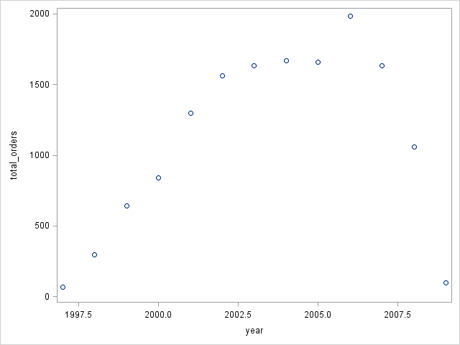
Exploratory Analysis
Categorization of orders
Categorization of customers
Interesting Patterns and Trends

Slide 7
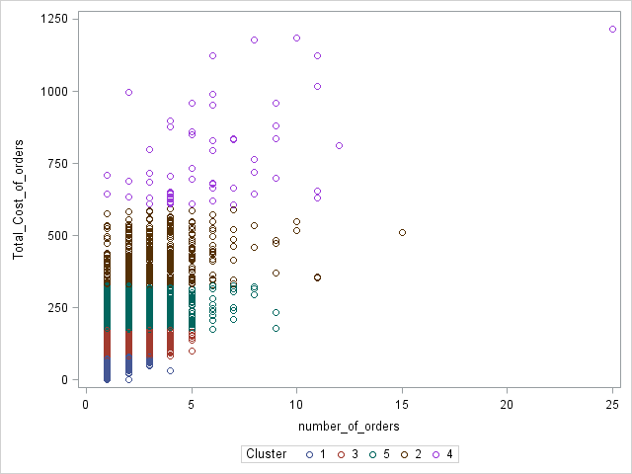
Developing Marketing Insights
Performed k-means for identifying customer segments.

Slide 8
Developing Marketing Insights
Identified Market Segments
Big Spenders
Small/Single/One time customers
Discount/Promotion driven customers
Repeat customers
Web customers
Print customers
Combination of web and print customers

Slide 9
Developing Marketing Insights
Obs | State | total_catalog_orders | total_catalog_quantity | total_web_orders | total_web_quantity | total_other_orders | total_orders
1 | California | 790 | 2404 | 393 | 1032 | 68 | 1251
2 | New York | 757 | 2182 | 368 | 973 | 62 | 1187
3 | Pennsylvania | 680 | 2109 | 270 | 728 | 38 | 988
4 | Texas | 454 | 1265 | 261 | 643 | 30 | 745
5 | Florida | 446 | 1344 | 241 | 650 | 37 | 724

Slide 10
Developing Marketing Insights
Geographical Analysis
List zip codes by State
Add new column to the orders called State
Calculate the ratios for web/catalog orders and examine any changes across time and States
Examine top producing states and bottom producing states

Slide 11
Developing Marketing Insights
Returns Analysis
Highest state with returns identified
Highest zip codes with returns per state flagged

